Slide 1
Across 2D and 3D: Learning from noisy information
Zhuo Li

Slide 2
When Noisy Labels Meet Long Tail Dilemmas: A Representation Calibration Method (ICCV 2023 final list paper)
Learning Signed Distance Functions from Noisy 3D Point Clouds via Noise to Noise Mapping (ICML 2023 Oral)

Slide 3
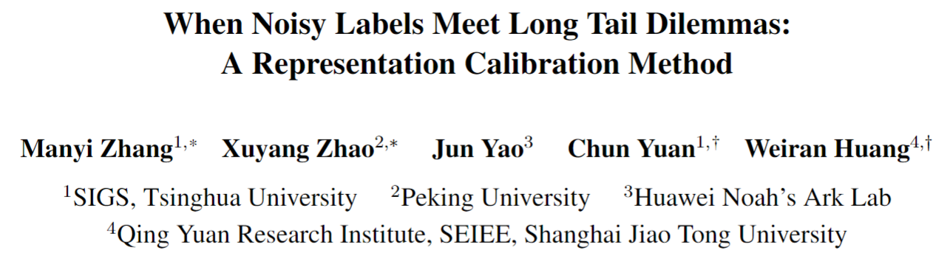
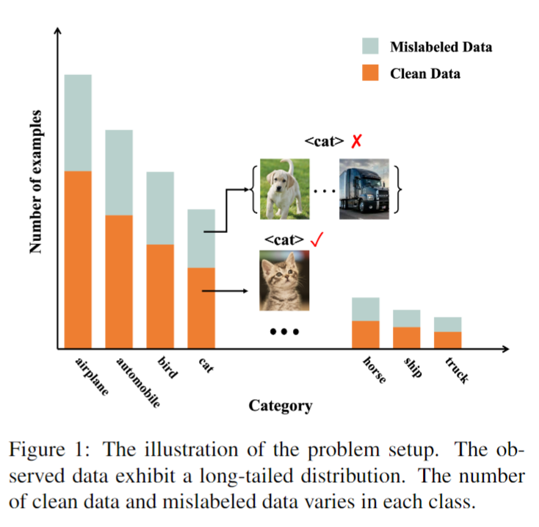
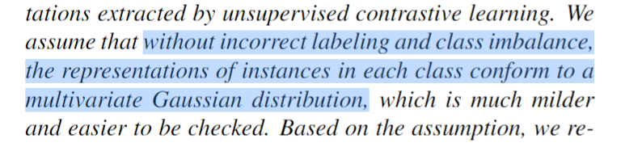
What is this paper for?
Learning with noisy labels on long-tailed data.

Slide 4
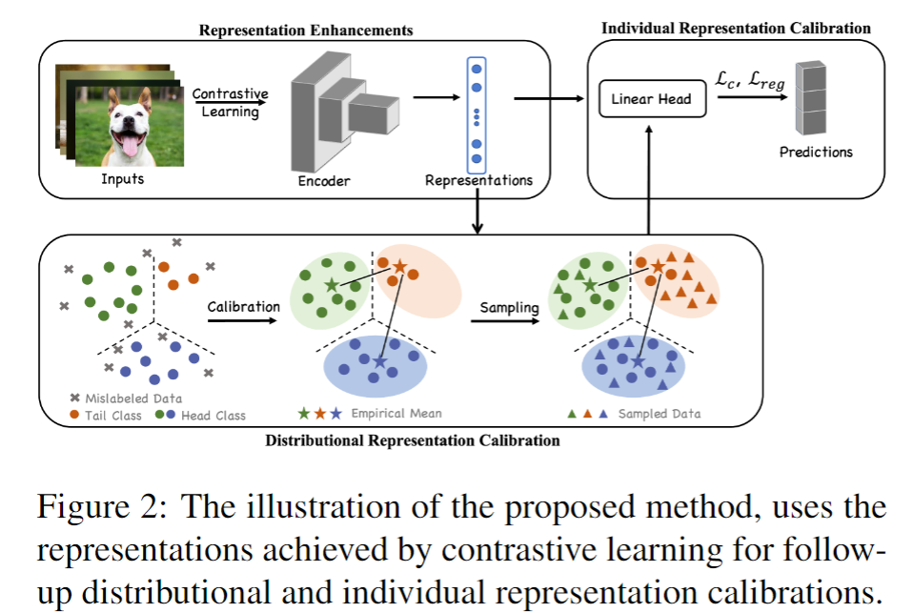
Method

Slide 5
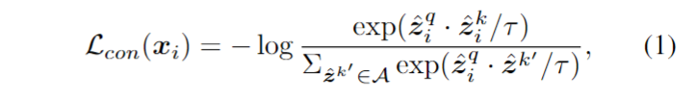
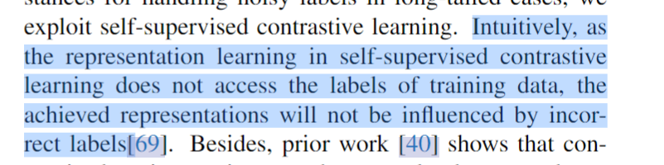
Method
1. Enhancing Representations by Contrastive Learning

Slide 6
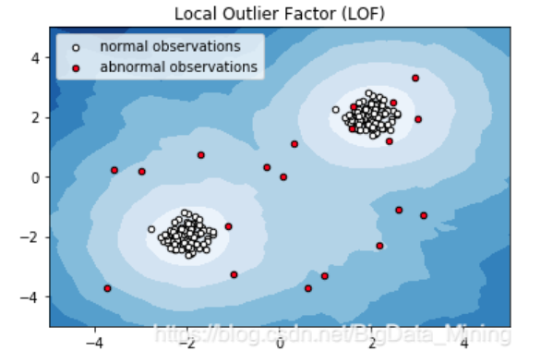
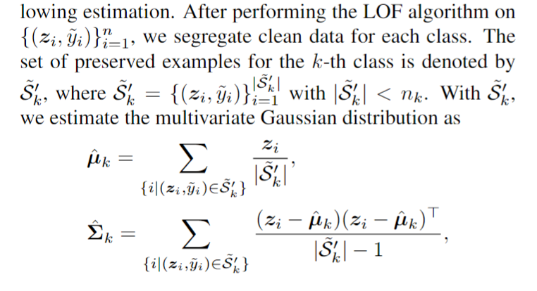
Method
2. Distributional Representation Calibration

Slide 7
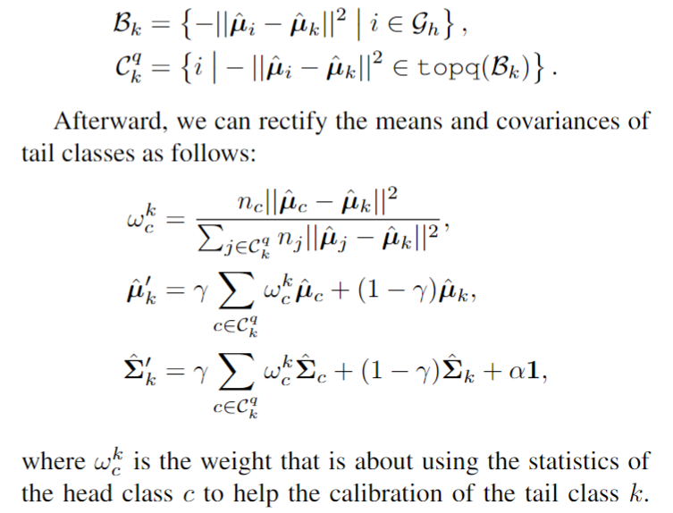
Method
2. Distributional Representation Calibration

Slide 8
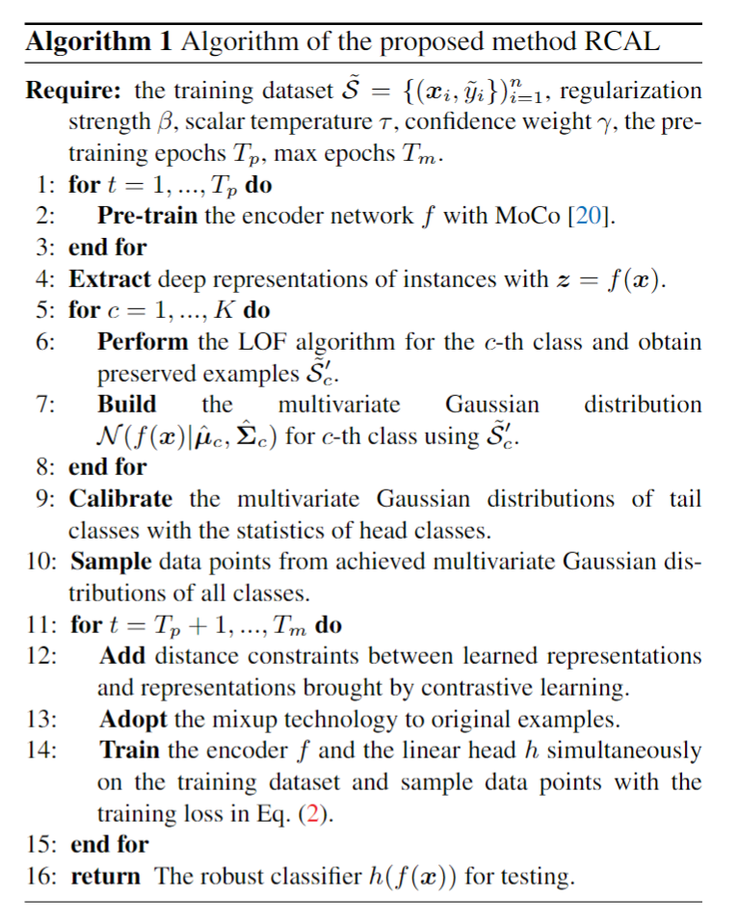
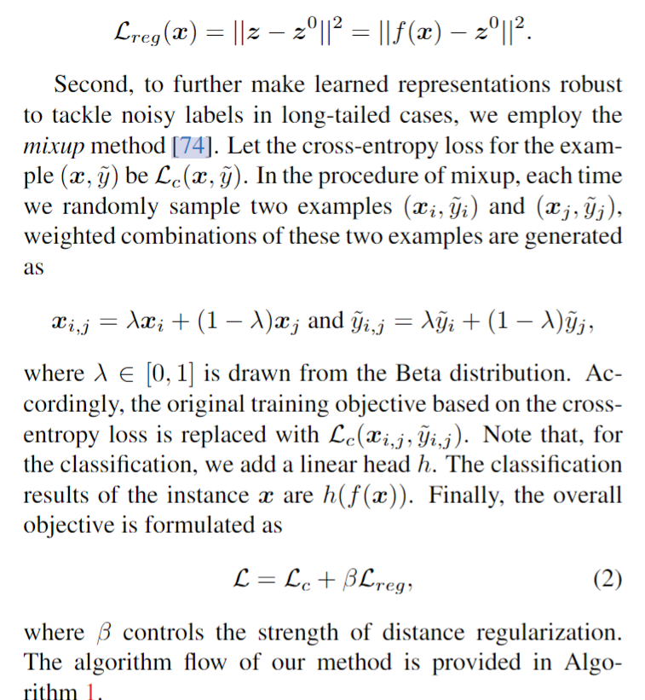
Method
3. Individual Representation Calibration

Slide 9
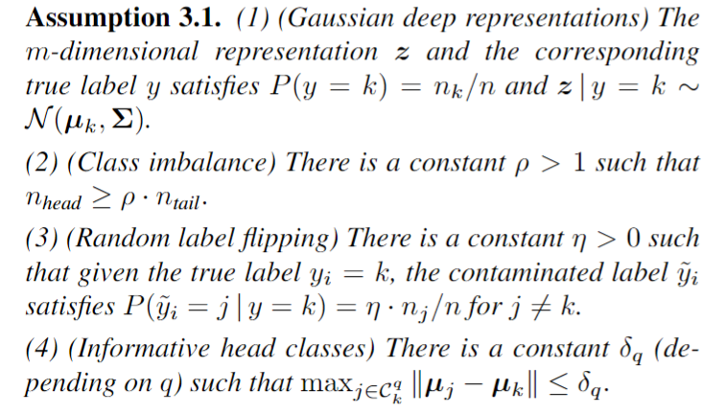
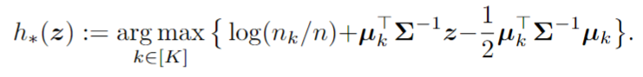
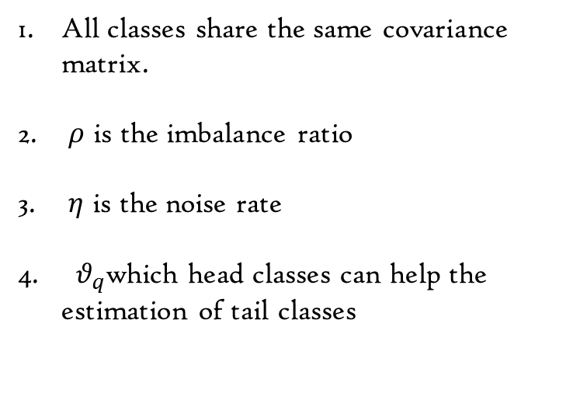
Method
4. Theoretical Analysis
All classes share the same covariance matrix.
$ρ$ is the imbalance ratio
$η$ is the noise rate
$θ_{q}$which head classes can help the estimation of tail classes
Bayes optimal classifier

Slide 10
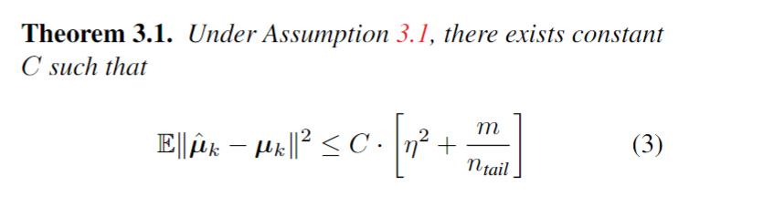
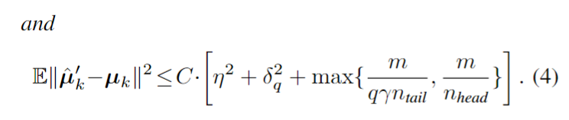
Method
4. Theoretical Analysis

Slide 11
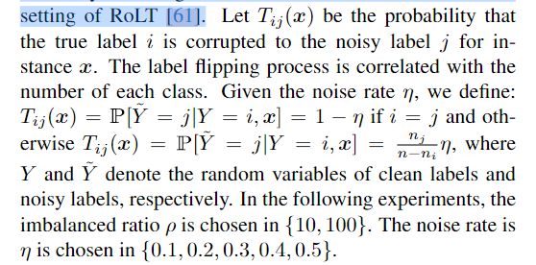
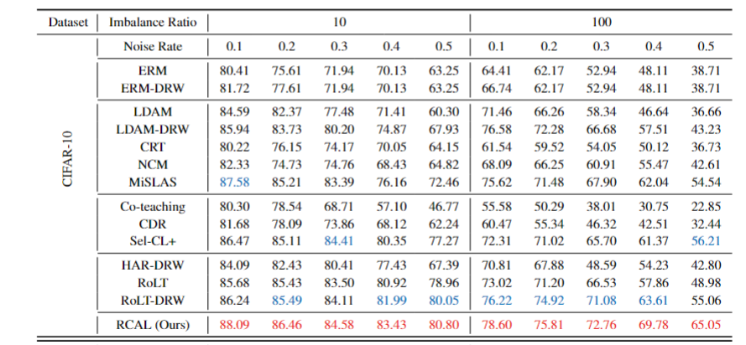
Experiments

Slide 12
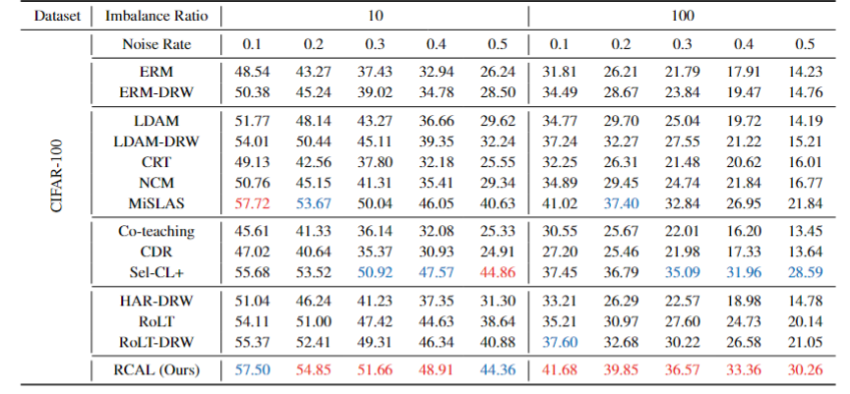
Experiments

Slide 13
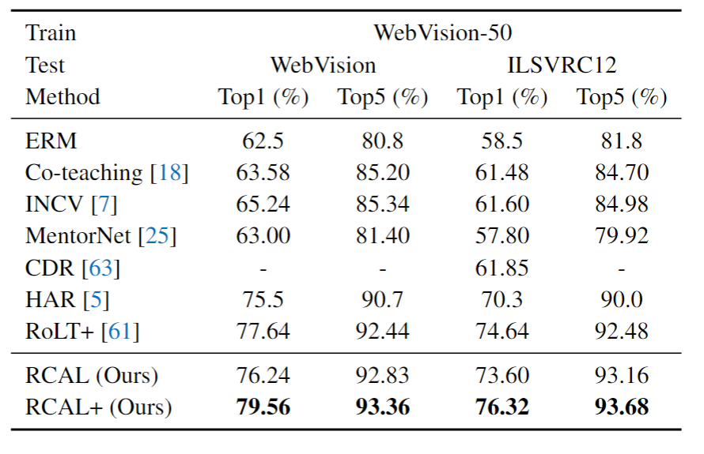
Experiments

Slide 14
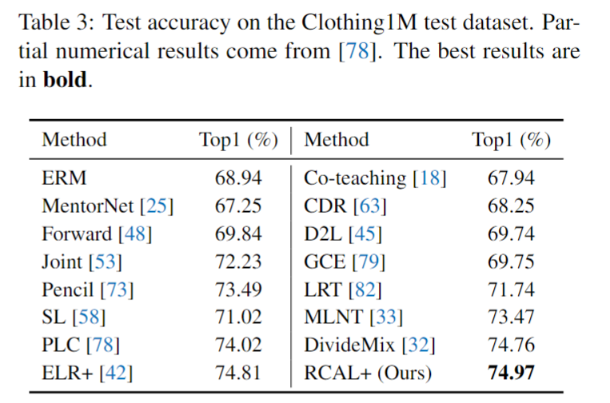
Experiments

Slide 15
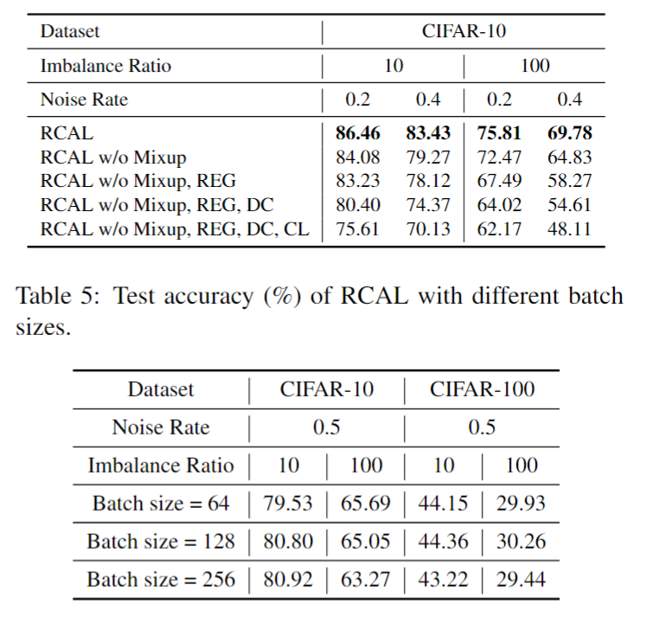
Experiments

Slide 16
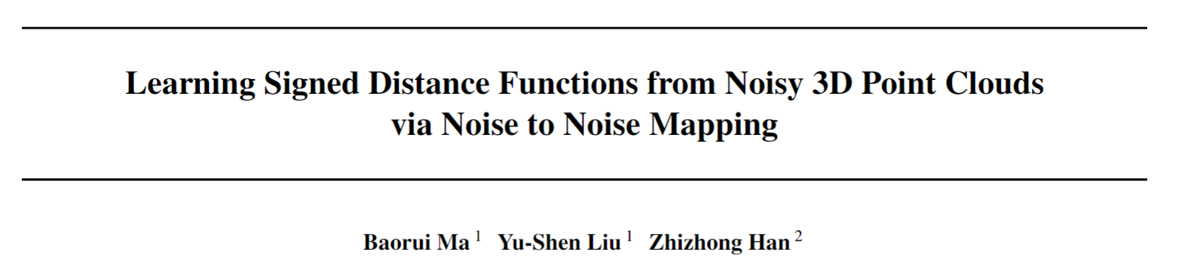
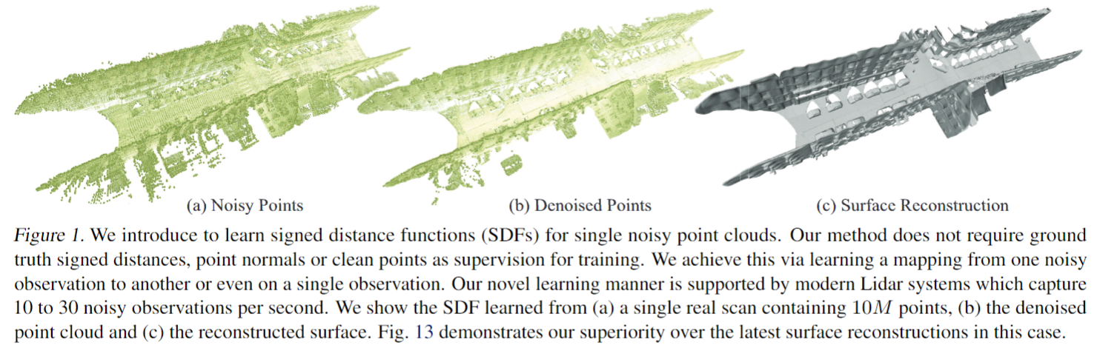
What is this paper for?
How to learn a better SDF (network) for point cloud surface reconstruction, denoising and up-sampling.

Slide 17
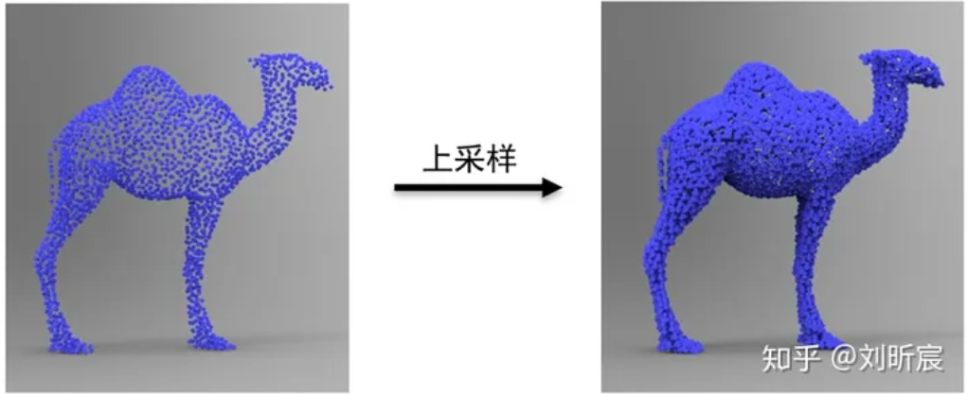

Slide 18
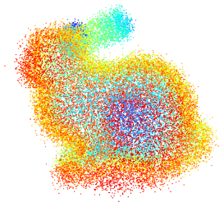
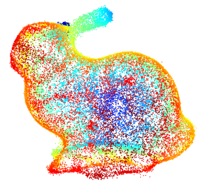
Denoising

Slide 19
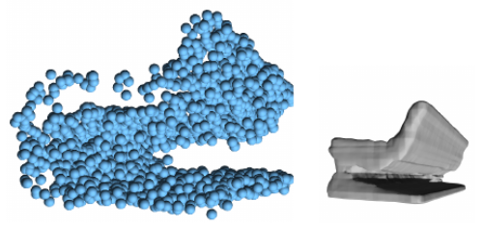
Surface Reconstruction

Slide 20
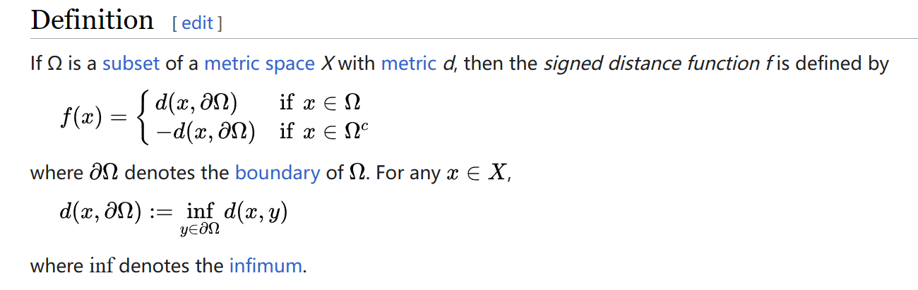
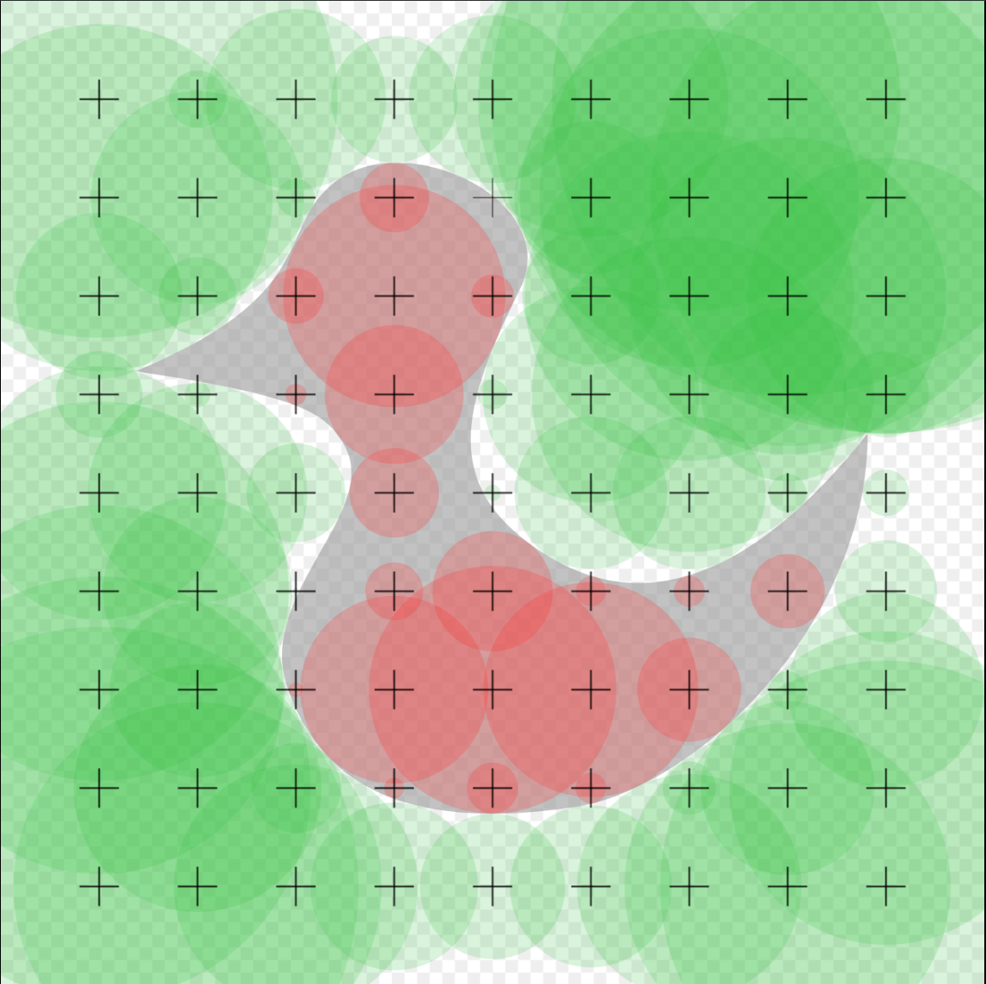
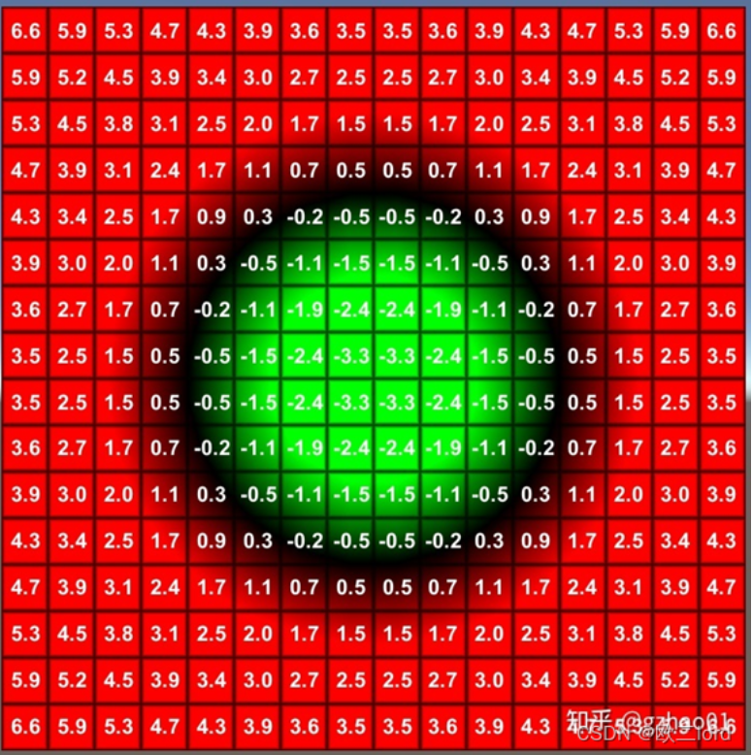
What is Signed Distance Functions (SDFs) ?

Slide 21
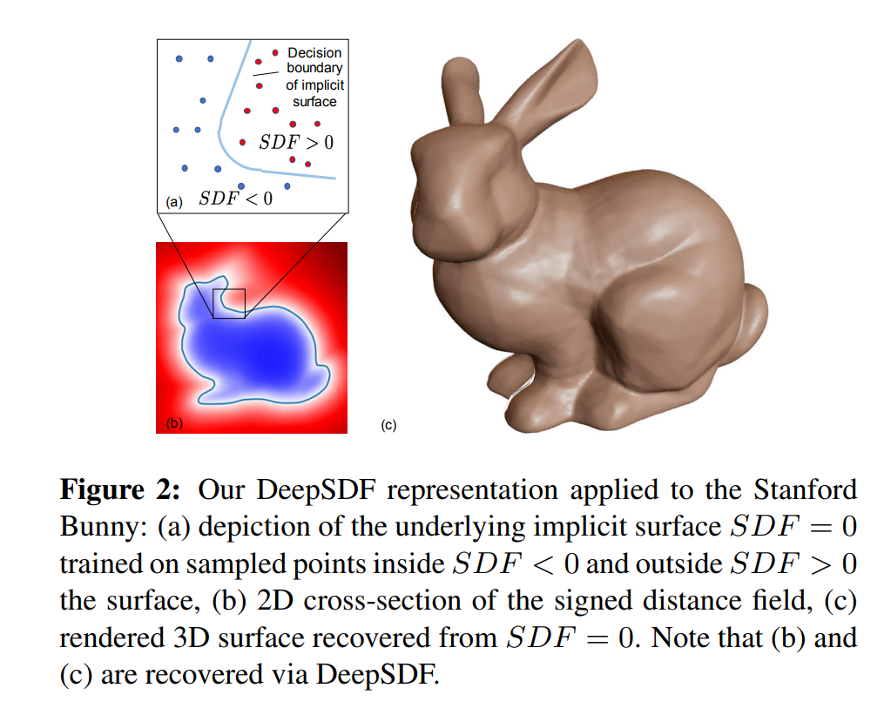
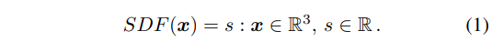
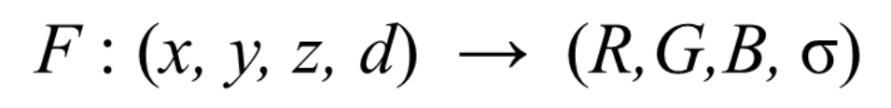
What is Signed Distance Functions (SDFs) ?
Difference with NeRF
SDF:
NeRF:
DeepSDF: Learning Continuous Signed Distance Functions for Shape Representation

Slide 22
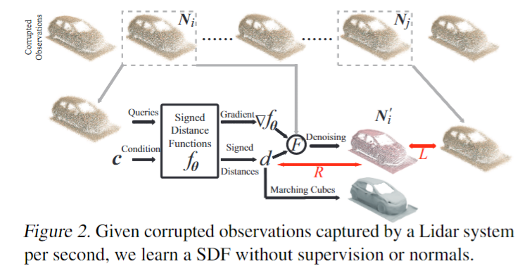
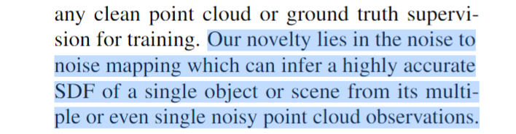
Challenges to learn better SDFs
1. Requirement of ground truth or no noise assumption.
Motivation
Contribution
Learn SDFs from noisy point clouds without requiring GT.
Leverage EMD to perform the statistical reasoning.
SOTA performance

Slide 23
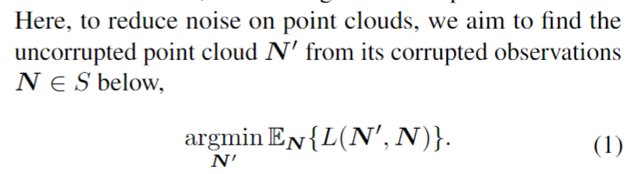
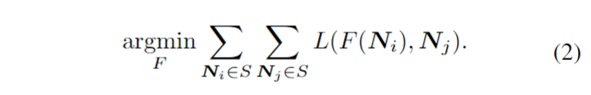
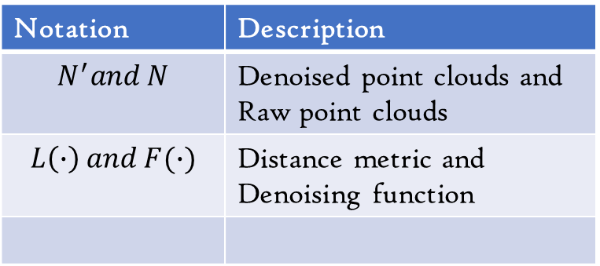
Notation | Description
$$N^{′}and N$$ | Denoised point clouds and Raw point clouds
$$L\left(∙\right) and F(∙)$$ | Distance metric and Denoising function
Method
Reducing Noise (Motivated by Noise2Noise, N2N)
Pushing a denoised image to be similar to as many corrupted observations as possible

Slide 24
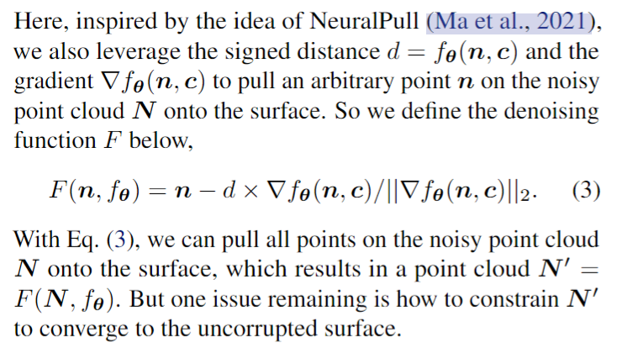
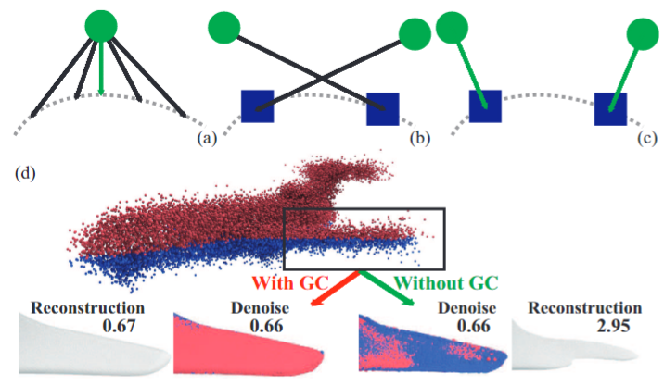
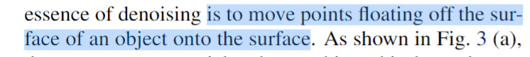
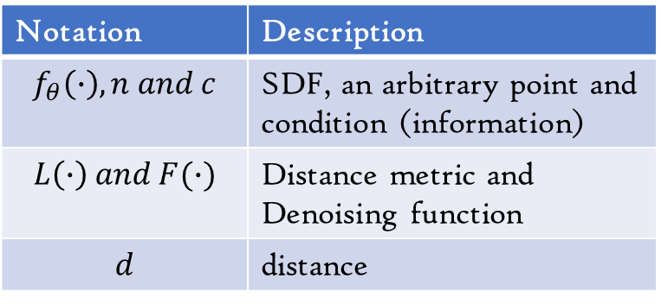
Notation | Description
$$f_{θ}\left(∙\right), n and c$$ | SDF, an arbitrary point and condition (information)
$$L\left(∙\right) and F(∙)$$ | Distance metric and Denoising function
$$d$$ | distance
Method
2. Denoising Function
Notes:
Pull不能保证把所有点都拉到surface上，而且有些outliers的cost会很大，更好的办法应该是有一个adaptive的东西进去，决定是pull还是drop。此外，可能会导致点的堆积，如果都选择最短距离。有些比较稀薄的区域没有点会被pull过去来填充

Slide 25
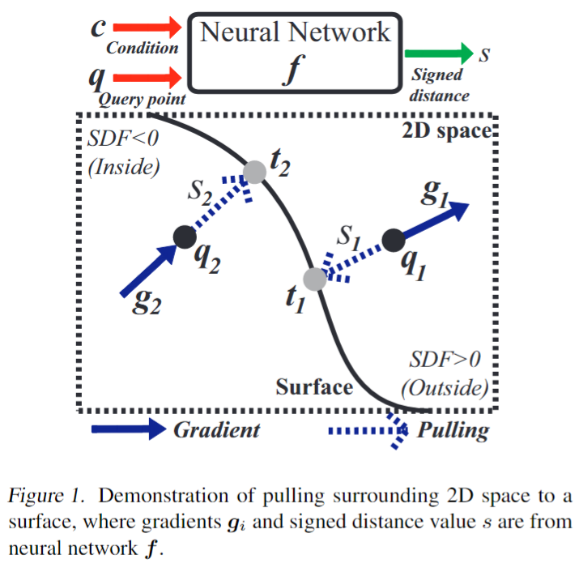
Method
2. Denoising Function
Neural-Pull: Learning Signed Distance Functions from Point Clouds by Learning to Pull Space onto Surfaces

Slide 26
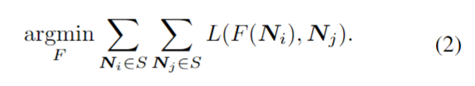
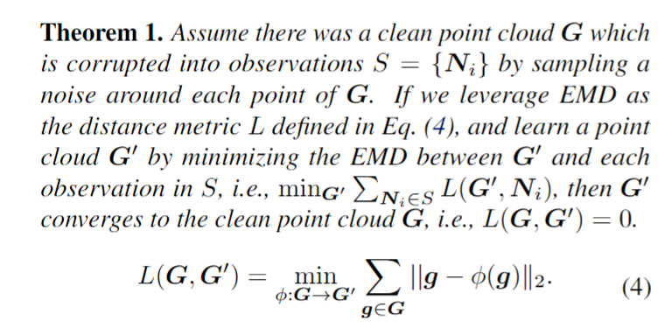
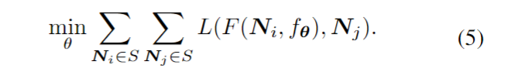
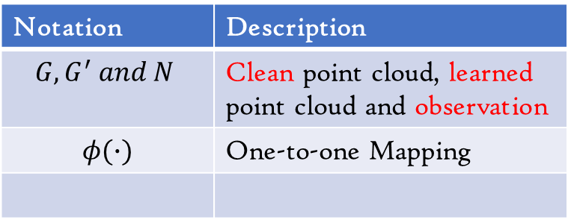
Notation | Description
$$G, G^{′} and N$$ | Clean point cloud, learned point cloud and observation
$$φ(∙)$$ | One-to-one Mapping
Method
3. Distance Metric
Recall：
Final optimization objective

Slide 27
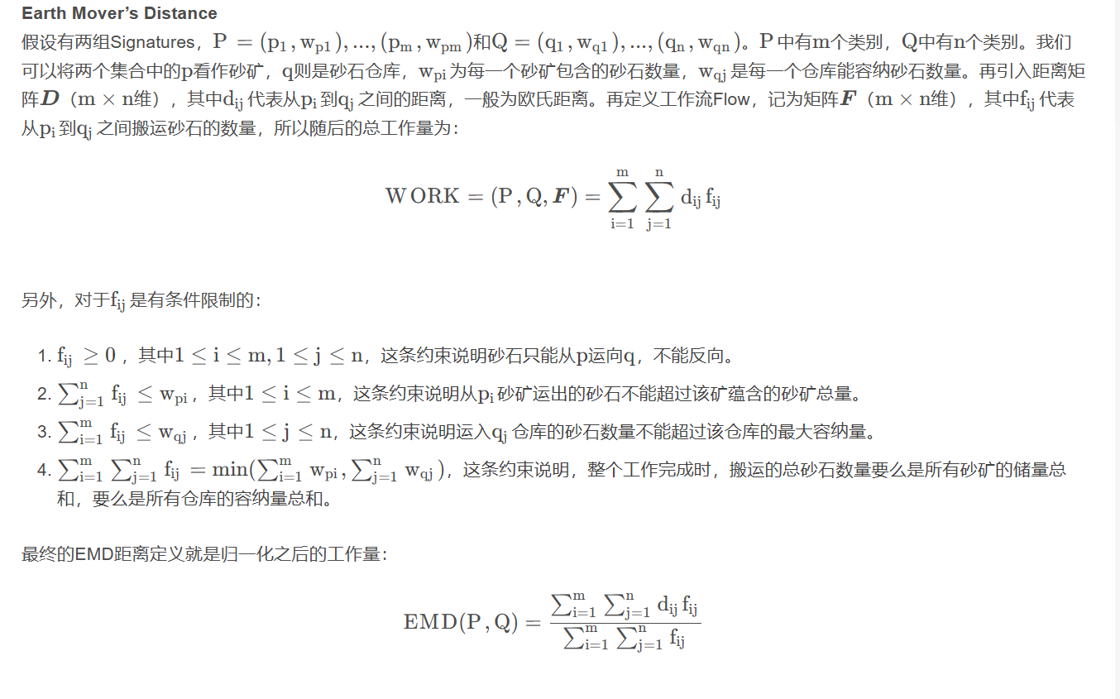
Method
Notes:
[Point Cloud] 点云分析中的EMD（Earth Mover's Distance）距离-CSDN博客

Slide 28
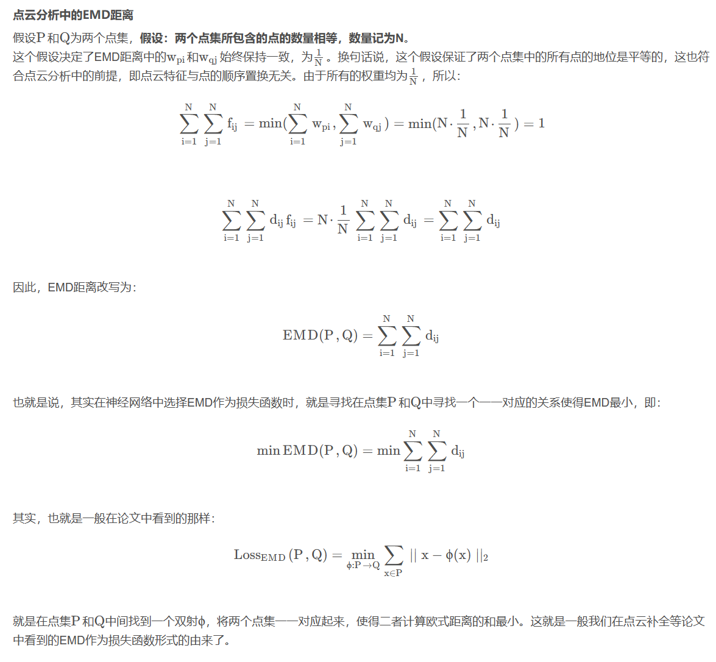
Method
Notes:
[Point Cloud] 点云分析中的EMD（Earth Mover's Distance）距离-CSDN博客

Slide 29



Method
3. Geometric Consistency

Slide 30

Method
4. Overall Loss Function
5. More Details

Slide 31

Experiments
1. Point Cloud Denoising

Slide 32

Experiments
1. Point Cloud Denoising

Slide 33

Experiments
2. Point Cloud Upsampling

Slide 34

Experiments
3. Surface Reconstruction

Slide 35

Experiments
3. Surface Reconstruction

Slide 36


Experiments
3. Surface Reconstruction

